Slide 1
Power Manager Telemetry
Category: Sustainability
Bavitesh M
6th Semester
Nitte Meenakshi Institute of Technology
Under the Guidance of
Dr. Shashidhara K S
Associate Professor
Dept. of Electronics and Communication Engineering

Slide 2
Problem Statment
The rise of 5G and edge computing has led to increased device deployment, resulting in higher power consumption. In response, the government is pushing for net-zero power usage amidst rising electricity costs.
Research and utilize open-source tools to measure and document system power usage from CPU, memory, NIC, and TDP, collect telemetry data to optimize power consumption based on system utilization percentage, and compiling a comprehensive report on the findings and solutions.

Slide 3
Unique Idea Brief (Solution)
Implemented the problem statement on AMD architecture.
Utilized open-source tools: Node Exporter, IPMI, Prometheus.
Visualized data using Grafana and inbuilt dependencies.
Collected preliminary power readings from Node Exporter and Prometheus.
Set up Docker environment for simulation; integrated Prometheus and Grafana for real-time monitoring.
Open Source Integration of various available tools.
Monitored power consumption both before and after implementation of stress using containers in Grafana.

Slide 4
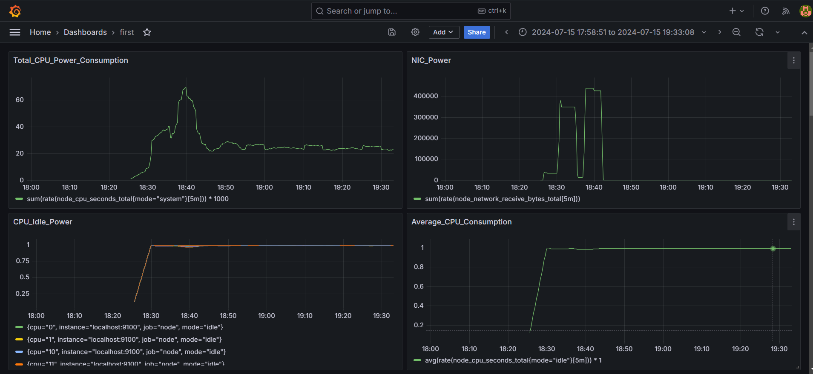
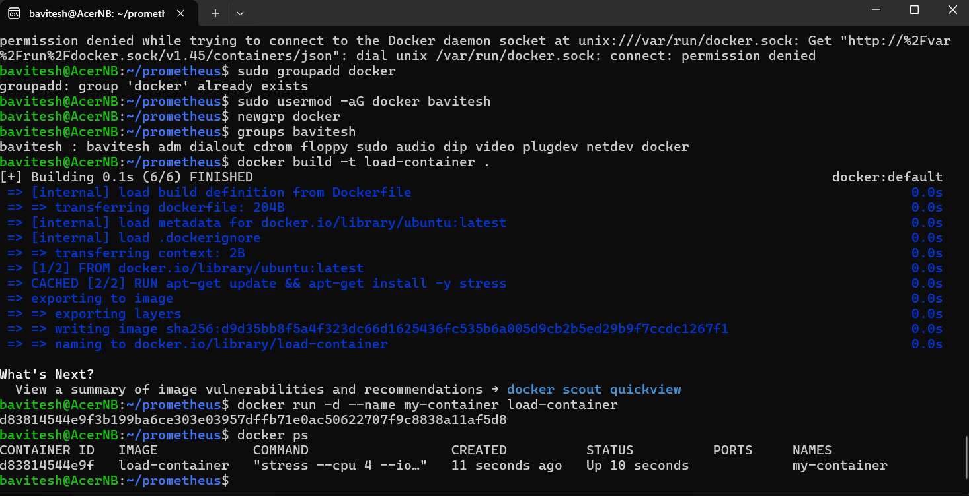
Implementation
The figures represent the implementation of grafana dashboard and running of stress containers

Slide 5
Features Offered
Real-time Power Consumption Monitoring
Dynamic System Utilization Simulation
Telemetry Data Collection
Node Exporter Integration
Hardware-level Monitoring
Customizable Grafana Dashboards
Dockerized Environment
Open-source Integration

Slide 6
Process flow
Install Docker
Setup Node and IPMI Exporter
Configure Prometheus and Grafana to collect and visualize power consumption metrics.
Access Grafana dashboard at http://localhost:3000 and Prometheus at http://localhost:9090.
Build Docker Images
Run Docker Container with appropriate parameters for system utilization.
Monitor Power Usage:
Use Grafana to monitor CPU, memory, NIC, and TDP power usage metrics.
Adjust system parameters and observe changes in power utilization dynamically.

Slide 7
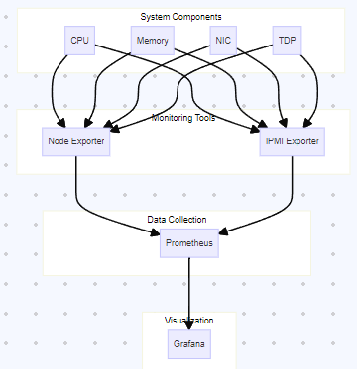
Architecture Diagram

Slide 8
Technologies used
Linux Distro: Ubuntu
Open-Source Tools: Node Exporter, IPMI, Powertop, Powerstat
Containerization: Docker for simulating system loads and managing containers
Monitoring and Visualization: Prometheus and Grafana for real-time metrics monitoring
Programming Languages: Python

Slide 9
Team members and contribution:
Bavitesh M:
Setup Prometheus tool for scraping of system data.
Conducted data collection using Node Exporter and in built Prometheus tools.
Set up Docker environments for simulating system loads and managing containers.
Integrated Prometheus and Grafana for real-time monitoring and visualization.
Measured and analyzed CPU power consumption under load.

Slide 10
Conclusion
In conclusion, the implementation of an Intelligent Power Management System using a combination of Node Exporter, IPMI, Docker, Prometheus, Grafana, was perfomed successfully. This integrated approach enabled precise power monitoring, simulation of system loads, and real-time visualization of metrics. Moving forward, we aim to enhance our system by integrating additional monitoring tools, refining optimization strategies based on data analysis, and ensuring scalability across diverse computing environments. Our commitment remains focused on achieving efficient power management and contributing to sustainability goals through continuous improvement and innovation.

